Slide 1
Transfer Learning

Slide 2

Workshop Overview for Day 1
Intro Lecture
9:00 - 10:00
Pavlos
Keynote Address
10:00 – 11:00
Latanya Sweeney
Basic Transfer Learning
11:00 - 12:30
Marios
Lunch
12:30 - 1:30
Project Time
3:00 - 4:30
Rashmi
Network Distillation
2:00 - 2:45
Hayden
Similarity using Embeddings
1:30 - 2:00
Marios

Slide 3
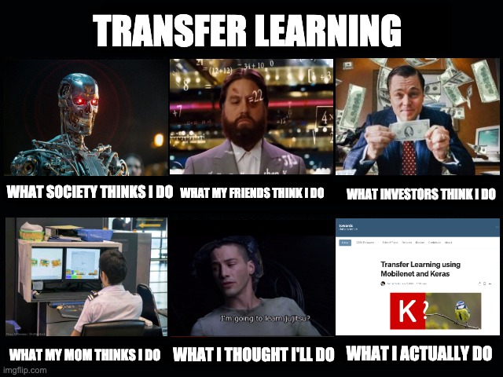

Slide 4
Outline
2: Review of CNNs
3: Motivation
3: The Basics idea for Transfer Learning
4: Representation Learning
5: Transfer Learning Strategies
6: Transfer Learning for Deep Learning

Slide 5
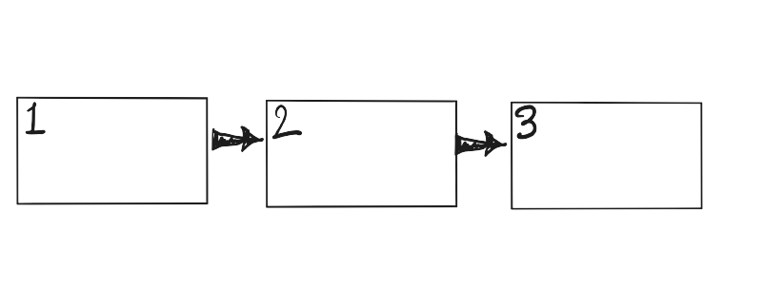
THE STORY OF TRANSFER LEARNING
CNNs: The success
CNNs: The failure
CNNs: The revolution

Slide 6

CNNs: Story so far
IMAGENET challenge:
A large visual database designed for use in visual object recognition software research
More than 14 million images have been hand-annotated by the project to indicate what objects are pictured and in at least one million of the images, bounding boxes are also provided

Slide 7
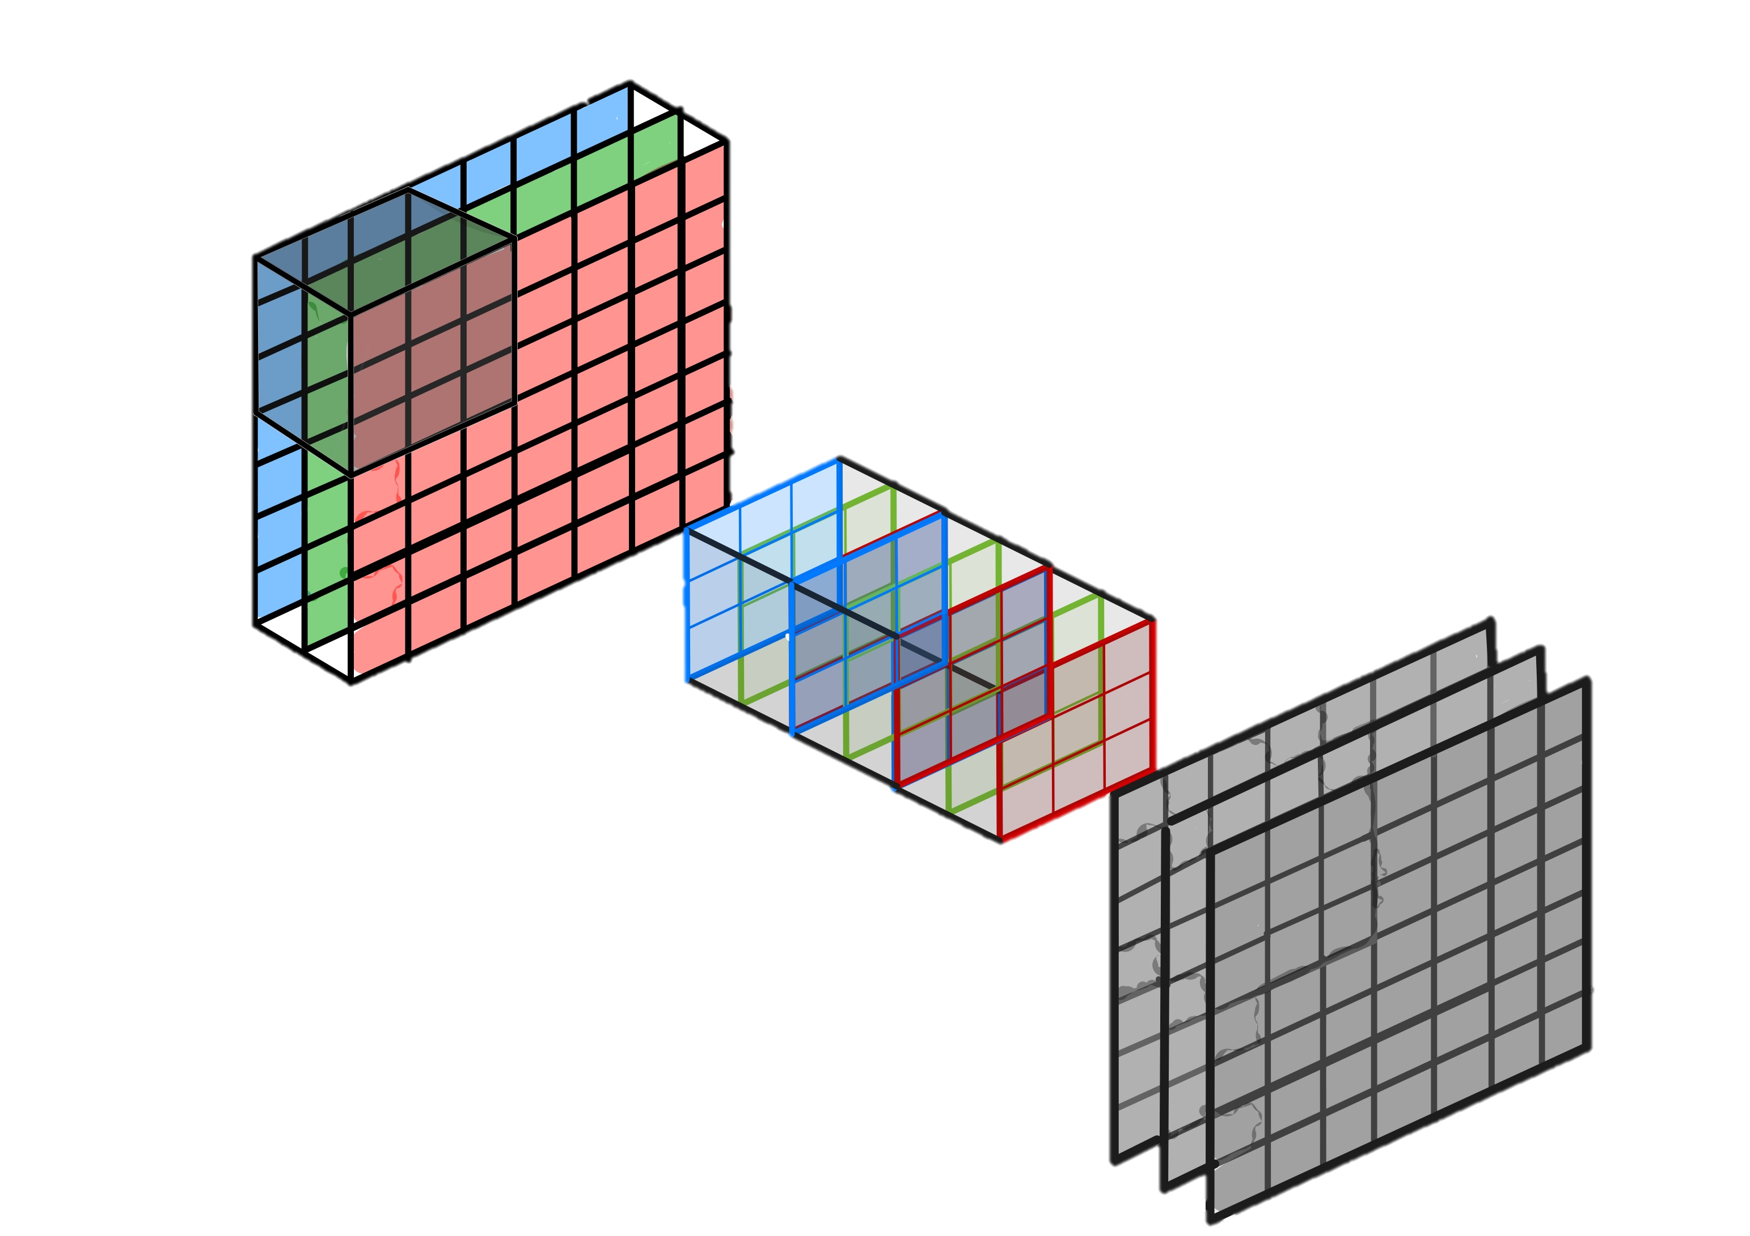

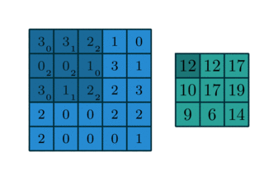
CNNs: “Convolution” Operation
A convolutional neural network typically consists of feature extracting layers and condensing layers.
The feature extracting layers are called convolutional layers & each node in these layers uses a small fixed set of weights to transform the image in the way below.
This set of fixed weights for each node in the convolutional layer is often called a filter.
RGB Image
(7x7x3)
Feature Maps
(7x7x3)
3 Convolution Filters
(3x3x3)

Slide 8

CNNs: Feature Extraction
Rather than processing image data with a pre-determined set of filters, we want to learn the filters of a CNN for feature extraction. Our goal is to extract features that best helps us to perform our downstream task (e.g. classification).
Idea:
We train a CNN for feature extraction and a model (e.g. MLP, decision tree, logistic regression) for classification, simultaneously and end-to-end.

Slide 9
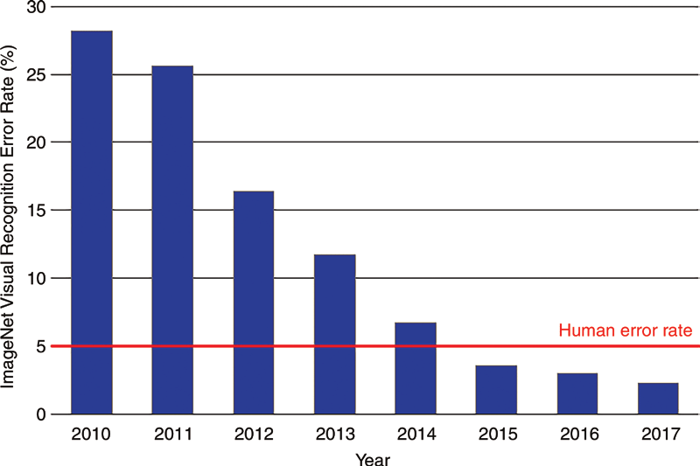
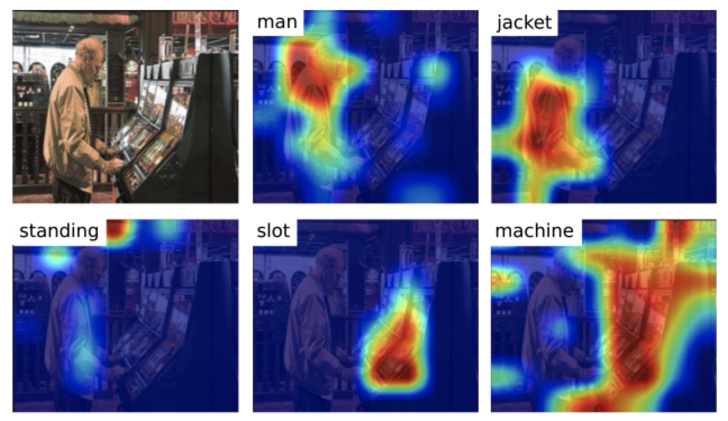
CNNs: Successful object detection
IMAGENET challenge:
New model architectures consistently outperform even human error rate
Ablation studies such as saliency maps and activations confirm models are not overfitting

Slide 10
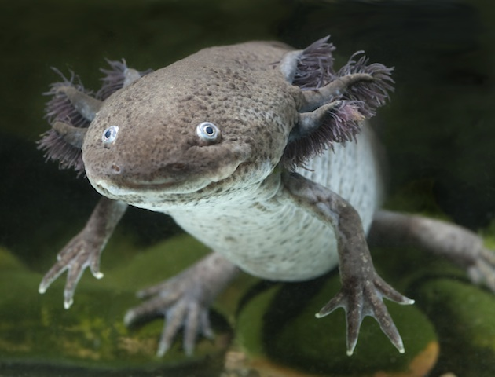
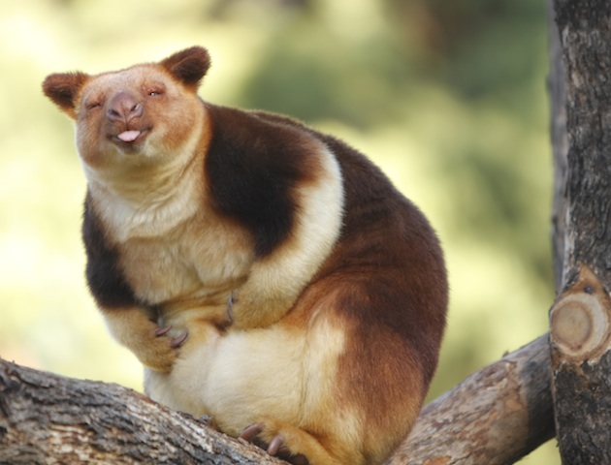
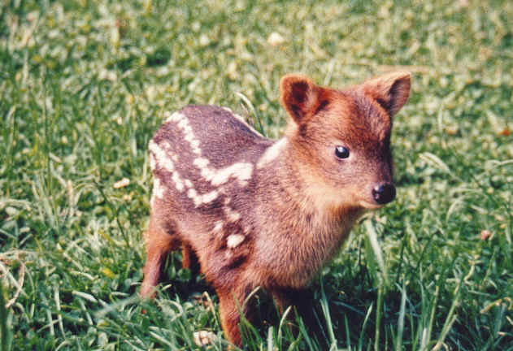
CNNs: So what is the problem?
IMAGENET has more than a 14 million label images and more than 1000 categories.
However, the imagenet challenge is only a very tiny subset of all possible categories for which we may not have a lot of training data.
Eg. Can you guess the animals in the images below?

Slide 11
Classify Rarest Animals
Notes:
axolotl mexican, tree kangaroo, pudu

Slide 12

Classify Rarest Animals
VGG16
Number of parameters: 134,268,737
Data Set: Few hundred images
Notes:
axolotl mexican, tree kangaroo, pudu

Slide 13
Classify Rarest Animals
VGG16
NOT ENOUGH DATA
Number of parameters: 134,268,737
Data Set: Few hundred images
Notes:
axolotl mexican, tree kangaroo, pudu

Slide 14
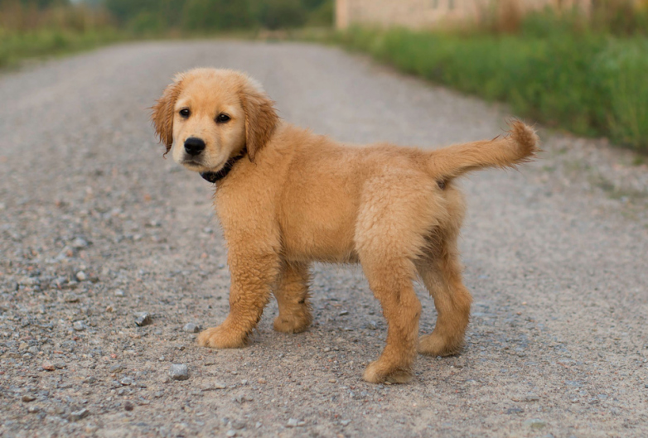
Classify Cats, Dogs, Chinchillas etc
VGG16

Slide 15
Classify Cats, Dogs, Chinchillas etc
VGG16
Number of parameters: 134,268,737
Enough training data. ImageNet approximate 1.2M

Slide 16
Classify Cats, Dogs, Chinchillas etc
VGG16
TAKES TOO LONG
Number of parameters: 134,268,737
Enough training data. ImageNet approximate 1.2M

Slide 17
Training time for SOTAs

Slide 18
Transfer Learning To The Rescue
How do you build an image classifier that can be trained in a few minutes on a CPU with very little data?
?

Slide 19
Basic idea of Transfer Learning
Wikipedia:
Transfer learning (TL) is a research problem in machine learning (ML) that focuses on storing knowledge gained while solving one problem and applying it to a different but related problem.^{[1]}

Slide 20
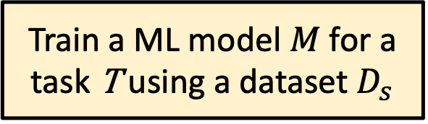
Basic idea of Transfer Learning
Train a ML model $M$ for a task T using a dataset $D_{s}$
Wikipedia:
Transfer learning (TL) is a research problem in machine learning (ML) that focuses on storing knowledge gained while solving one problem and applying it to a different but related problem.^{[1]}

Slide 21
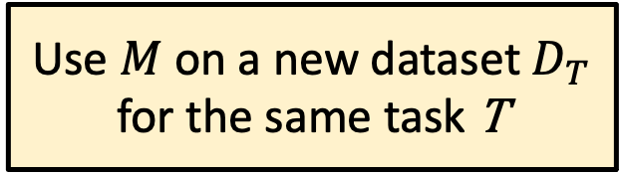
Basic idea of Transfer Learning
Train a ML model $M$ for a task T using a dataset $D_{s}$
Wikipedia:
Transfer learning (TL) is a research problem in machine learning (ML) that focuses on storing knowledge gained while solving one problem and applying it to a different but related problem.^{[1]}
Use $M$ on a new dataset $D_{T}$ for the same task T

Slide 22
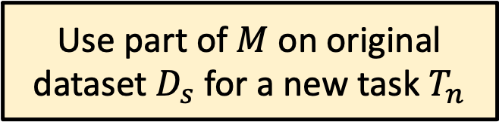
Basic idea of Transfer Learning
Train a ML model $M$ for a task T using a dataset $D_{s}$
Wikipedia:
Transfer learning (TL) is a research problem in machine learning (ML) that focuses on storing knowledge gained while solving one problem and applying it to a different but related problem.^{[1]}
Use $M$ on a new dataset $D_{T}$ for the same task T
Use part of $M$ on original dataset $D_{s}$ for a new task $T_{n}$

Slide 23
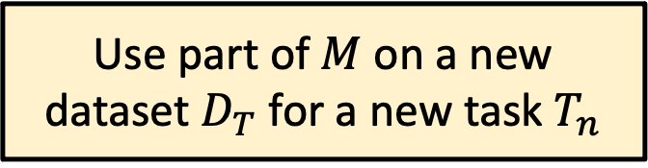
Basic idea of Transfer Learning
Train a ML model $M$ for a task T using a dataset $D_{s}$
Wikipedia:
Transfer learning (TL) is a research problem in machine learning (ML) that focuses on storing knowledge gained while solving one problem and applying it to a different but related problem.^{[1]}
Use $M$ on a new dataset $D_{T}$ for the same task T
Use part of $M$ on original dataset $D_{s}$ for a new task $T_{n}$
Use part of $M$ on a new dataset $D_{T}$ for a new task $T_{n}$

Slide 24
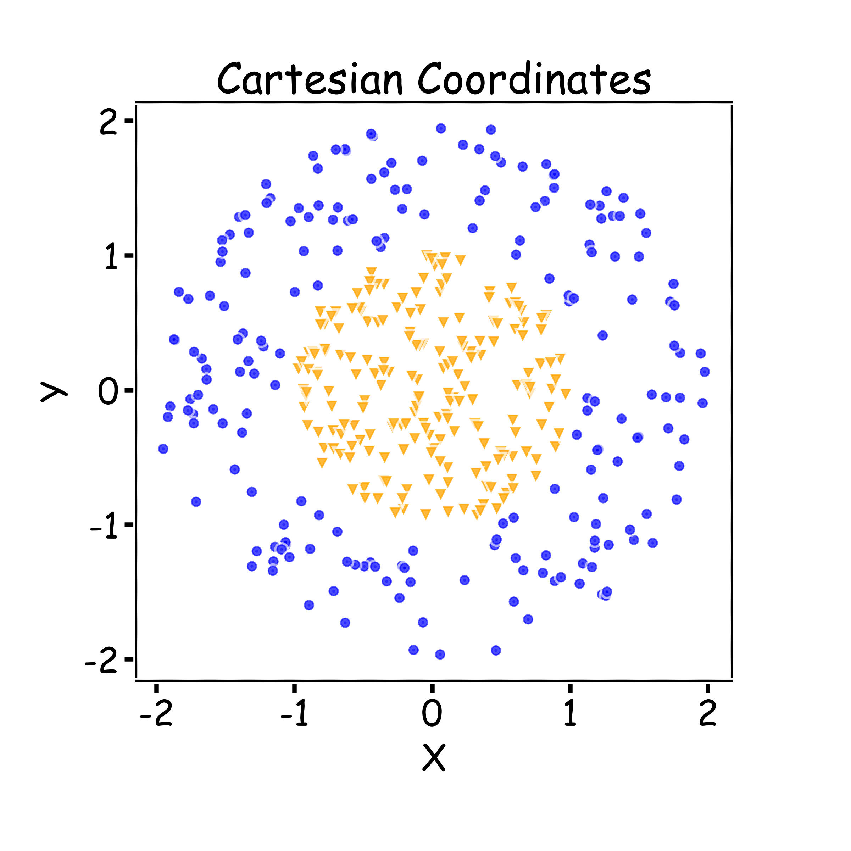
Key Idea: Representation Learning

Slide 25
Key Idea: Representation Learning
Relatively difficult task

Slide 26
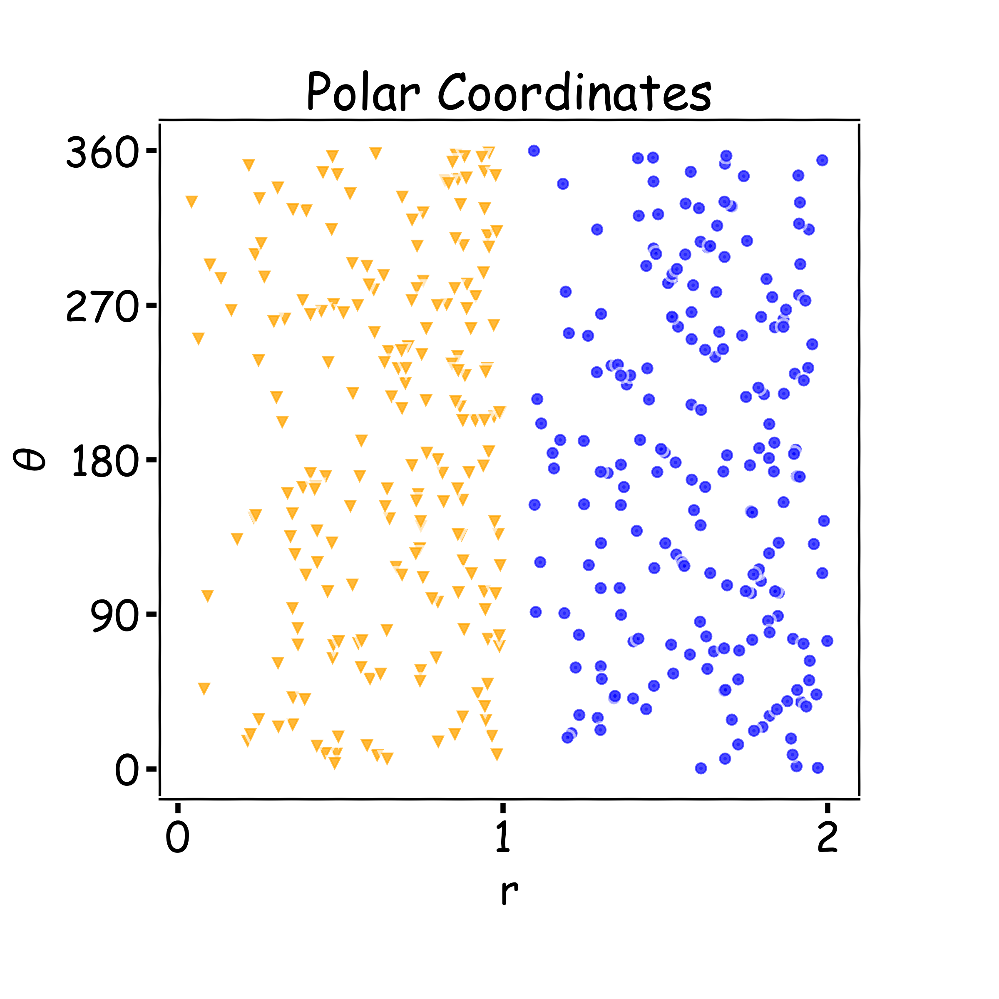
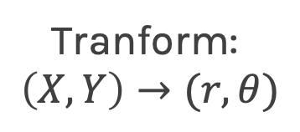
Key Idea: Representation Learning
Relatively difficult task
Tranform:
$$\left(X,Y\right)→(r,θ)$$

Slide 27
Key Idea: Representation Learning
Relatively difficult task
Easier task
Tranform:
$$\left(X,Y\right)→(r,θ)$$

Slide 28
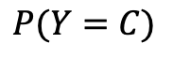
Representation Learning
Task: classify cars, people, animals and objects
FCN
CNN Layer 1
CNN Layer 2
CNN Layer n
…
$$P(Y=C)$$

Slide 29
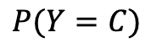
Representation Learning
Task: classify cars, people, animals and objects
FCN
CNN Layer 1
CNN Layer 2
CNN Layer n
…
$$P(Y=C)$$

Slide 30
Representation Learning
Task: classify cars, people, animals and objects
FCN
CNN Layer 1
CNN Layer 2
CNN Layer n
…
$$P(Y=C)$$

Slide 31
Representation Learning
Task: classify cars, people, animals and objects
FCN
CNN Layer 1
CNN Layer 2
CNN Layer n
…
$$P(Y=C)$$

Slide 32
Transfer Learning To The Rescue
How do you make an image classifier that can be trained in a few minutes on a CPU with very little data?

Slide 33
Transfer Learning To The Rescue
How do you make an image classifier that can be trained in a few minutes on a CPU with very little data?
Use pre-trained models, i.e., models with known weights.

Slide 34
Transfer Learning To The Rescue
How do you make an image classifier that can be trained in a few minutes on a CPU with very little data?
Use pre-trained models, i.e., models with known weights.
Main Idea: earlier layers of a network learn low level features, which can be adapted to new domains by changing weights at later and fully-connected layers.

Slide 35
Transfer Learning To The Rescue
How do you make an image classifier that can be trained in a few minutes on a CPU with very little data?
Use pre-trained models, i.e., models with known weights.
Main Idea: earlier layers of a network learn low level features, which can be adapted to new domains by changing weights at later and fully-connected layers.
Example: use ImageNet trained with any sophisticated huge network. Then retrain it on a few images

Slide 36
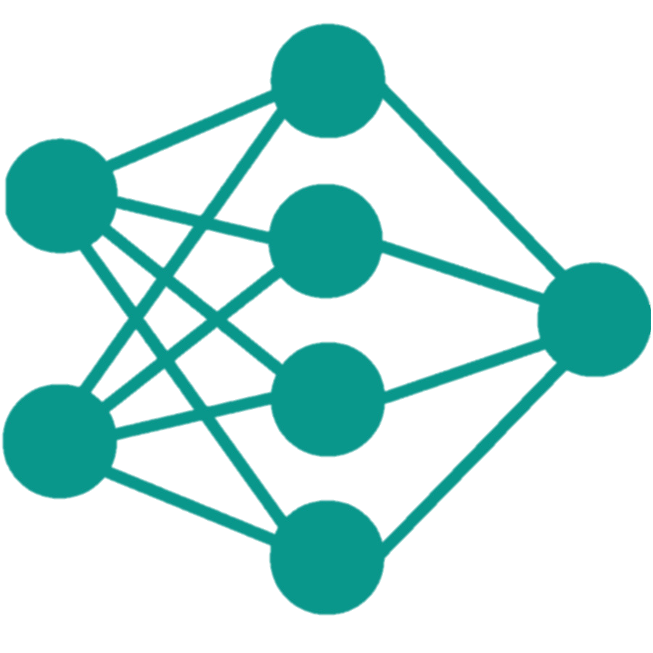
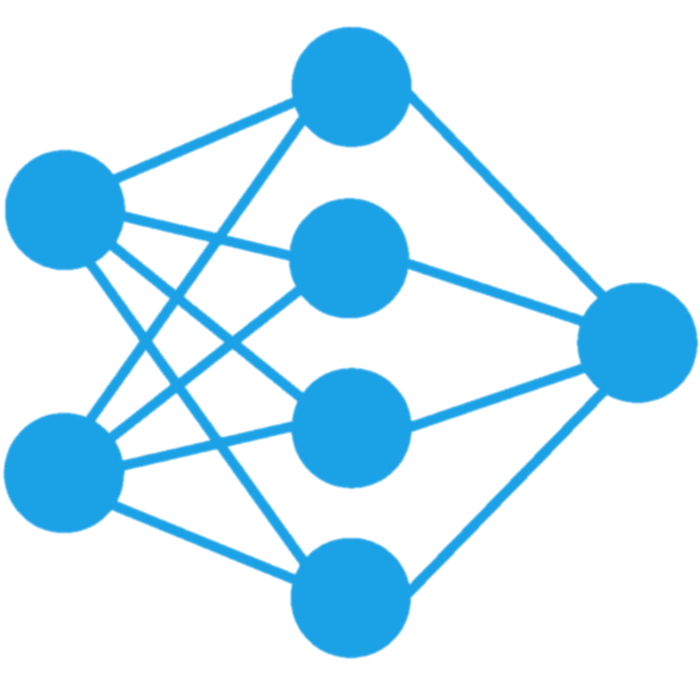
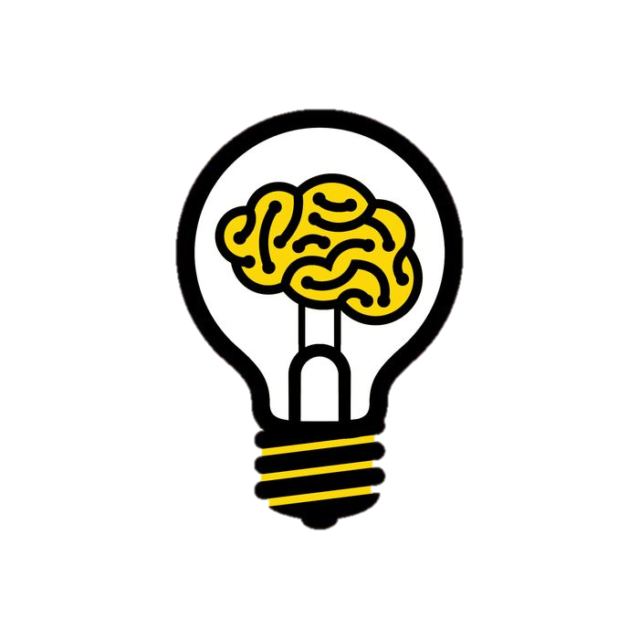
Traditional Machine Learning vs Transfer Learning
Training Items
Training Items
Learning System #1
Learning System #2
Knowledge
Learning Systems

Slide 37
Transfer Learning
Pre-train network such as VGG, etc
Train only this
FCN
CNN Layer 1
CNN Layer 2
CNN Layer n
…
$$P(Y=C)$$

Slide 38
Transfer Learning
Pre-train network
Train this
FCN
CNN Layer 1
CNN Layer 2
CNN Layer n
…
$$P(Y=C)$$

Slide 39
Transfer Learning – fine tuning
Train everything but start with weights that are trained already
FCN
CNN Layer 1
CNN Layer 2
CNN Layer n
…
$$P(Y=C)$$

Slide 40
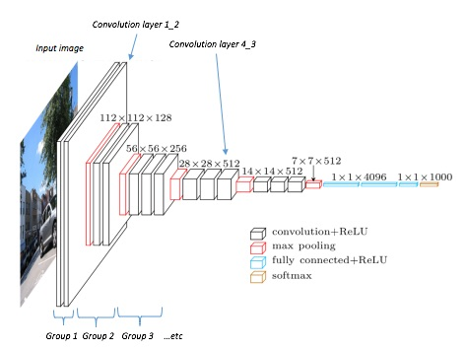
Transfer Learning Across Tasks
Classification:
P(cat)
P(chinchilla)
P(dog)

Slide 41
Transfer Learning Across Tasks
Classification:
P(cat)
P(chinchilla)
P(dog)
Object Detection:

Slide 42
Transfer Learning Across Tasks
Classification:
P(cat)
P(chinchilla)
P(dog)
Object Detection:

Slide 43
Transfer Learning Across Tasks (cont)
Classification:
P(cat)
P(chinchilla)
P(dog)
Segmentation:

Slide 44
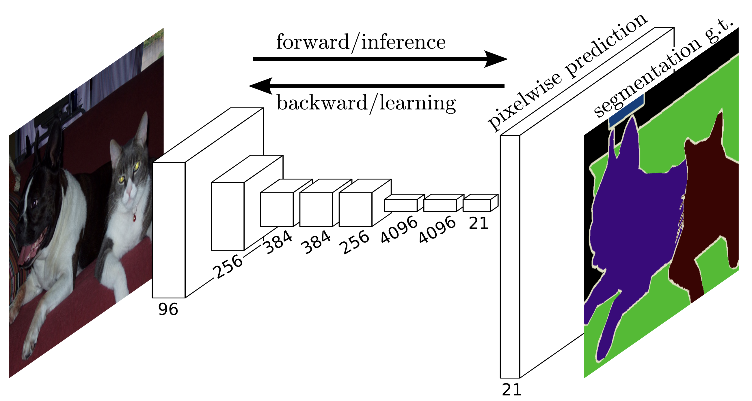
Segmentation

Slide 45
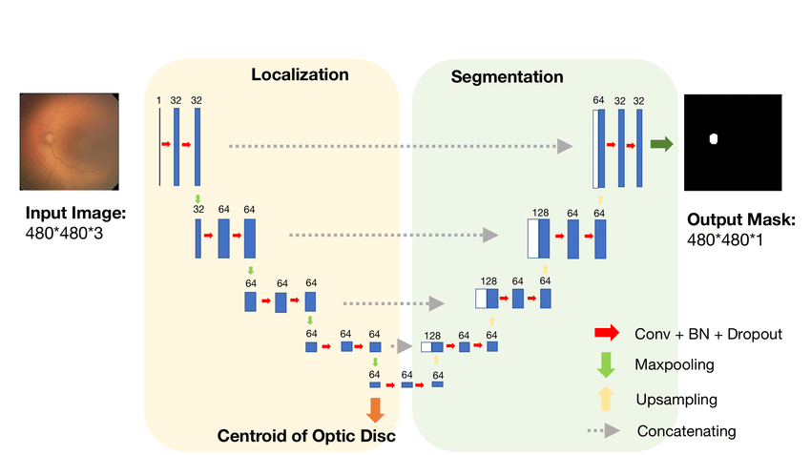
Segmentation: U-net architecture
Pre-train network
Train this
Notes:
U-Net consists of an almost symmetric encoder and decoder.
it has skip connections from the output of convolution blocks to the corresponding input of the transposed-convolution block at the same level: these skip connections allow gradients to flow more effectively and provides information from multiple scales of the image.

Slide 46
Segmentation (fine tuning)
Fine tune

Slide 47
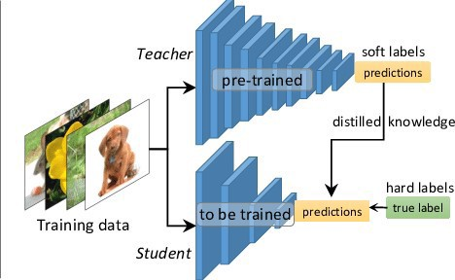
Transfer Learning through Network Distillation
Question: is it possible to distill and compress the knowledge of the large and complex training model (the teacher) into a small and simple deployment model (the student)?
Standard cross entropy with correct labels
Cross entropy with the output from the teacher network predictions

Slide 48
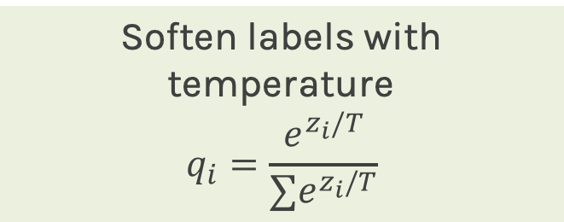
Transfer Learning through Network Distillation (temperature)
Standard cross entropy with correct labels
Soften labels with temperature
$$q_{i}=\frac{e^{z_{i}/T}}{∑e^{z_{i}/T}}$$
Cross entropy with the soft targets from the teacher network predictions

Slide 49
Transfer learning – The details
Transfer Learning for Deep Learning
What people think
You can’t do deep learning unless you have a million labeled examples.
What people can do, instead
You can learn representations from unlabeled data.
You can train on a nearby objective for which is easy to generate labels (ImageNet).
You can transfer learned representations from a relate task.

Slide 50
Transfer learning – The details
Prediction
Feature-Representation Extraction
Head
randomly initialize
Use representations learned by big net to extract features from new samples, which are then fed to a new classifier:
Base Trained CNN
FREEZE
Input

Slide 51
Transfer learning – The details
Prediction
Feature-Representation Extraction
Head
randomly initialize
Use representations learned by big net to extract features from new samples, which are then fed to a new classifier:
• Keep (frozen) convolutional base from big model.
Base Trained CNN
FREEZE
Input

Slide 52
Transfer learning – The details
Prediction
Feature-Representation Extraction
Head
randomly initialize
Use representations learned by big net to extract features from new samples, which are then fed to a new classifier:
• Keep (frozen) convolutional base from big model.
• Generally throw away head FC layers since these have no notion of space, and convolutional base is more generic.
Base Trained CNN
FREEZE
Input

Slide 53
Transfer learning – The details
Prediction
Feature-Representation Extraction
Head
randomly initialize
Use representations learned by big net to extract features from new samples, which are then fed to a new classifier:
• Keep (frozen) convolutional base from big model.
• Generally throw away head FC layers since these have no notion of space, and convolutional base is more generic.
• Since there are both dogs and cats in ImageNet you could get away with using the head FC layers as well (instance TL). But by throwing it away you can learn more from other dog/cat images.
Base Trained CNN
FREEZE
Input

Slide 54
Fine-tuning
Prediction
Up to now we have frozen the entire convolutional base.
Head
randomly initialize
Fine tune some layers
Base Trained CNN
FREEZE
Input

Slide 55
Fine-tuning
Prediction
Up to now we have frozen the entire convolutional base.
Remember that earlier layers learn highly generic feature maps (edges, colors, textures).
Head
randomly initialize
Fine tune some layers
Base Trained CNN
FREEZE
Input

Slide 56
Fine-tuning
Prediction
Up to now we have frozen the entire convolutional base.
Remember that earlier layers learn highly generic feature maps (edges, colors, textures).
Later layers learn abstract concepts (dog’s ear).
To particularize the model to our task, its often worth tuning the later layers as well.
Head
randomly initialize
Fine tune some layers
Base Trained CNN
FREEZE
Input

Slide 57
Fine-tuning
Prediction
Up to now we have frozen the entire convolutional base.
Remember that earlier layers learn highly generic feature maps (edges, colors, textures).
Later layers learn abstract concepts (dog’s ear).
To particularize the model to our task, its often worth tuning the later layers as well.
But we must be very careful not to have big gradient updates.
Head
randomly initialize
Fine tune some layers
Base Trained CNN
FREEZE
Input

Slide 58
Procedure for Fine-tuning
Freeze the convolutional base.
First train the fully connected head you added, keeping the convolutional base fixed.
Unfreeze some "later" layers in the base net and now train the base net and FC net together.
Since you are now in a better part of the loss surface already, gradients won't be terribly high, but we still need to be careful. Thus often we use a very low learning rate.

Slide 59
Transfer Learning for Deep Learning: Differential Learning Rates
Prediction
• A low learning rate can take a lot of time to train on the "later" layers. Since we trained the FC head earlier, we could probably retrain them at a higher learning rate.
Dense Layer
Largest optimal learning rate
Dense Layer
Dense Layer
Conv Layer
Relatively larger learning rate
Conv Layer
Conv Layer
Conv Layer
Smaller learning rate
Conv Layer
Conv Layer
Input

Slide 60
Transfer Learning for Deep Learning: Differential Learning Rates
Prediction
• A low learning rate can take a lot of time to train on the "later" layers. Since we trained the FC head earlier, we could probably retrain them at a higher learning rate.
• General Idea: Train different layers at different rates.
Dense Layer
Largest optimal learning rate
Dense Layer
Dense Layer
Conv Layer
Relatively larger learning rate
Conv Layer
Conv Layer
Conv Layer
Smaller learning rate
Conv Layer
Conv Layer
Input

Slide 61
Transfer Learning for Deep Learning: Differential Learning Rates
Prediction
• A low learning rate can take a lot of time to train on the "later" layers. Since we trained the FC head earlier, we could probably retrain them at a higher learning rate.
• General Idea: Train different layers at different rates.
• Each "earlier" layer or layer group (the color-coded layers in the image) can be trained at 3x-10x smaller learning rate than the next "later" one.
Dense Layer
Largest optimal learning rate
Dense Layer
Dense Layer
Conv Layer
Relatively larger learning rate
Conv Layer
Conv Layer
Conv Layer
Smaller learning rate
Conv Layer
Conv Layer
Input

Slide 62
Transfer Learning for Deep Learning: Differential Learning Rates
Prediction
• A low learning rate can take a lot of time to train on the "later" layers. Since we trained the FC head earlier, we could probably retrain them at a higher learning rate.
• General Idea: Train different layers at different rates.
• Each "earlier" layer or layer group (the color-coded layers in the image) can be trained at 3x-10x smaller learning rate than the next "later" one.
• One could even train the entire network again this way until we overfit and then step back some epochs.
Dense Layer
Largest optimal learning rate
Dense Layer
Dense Layer
Conv Layer
Relatively larger learning rate
Conv Layer
Conv Layer
Conv Layer
Smaller learning rate
Conv Layer
Conv Layer
Input

Slide 63
Workshop Overview for Day 1
Intro Lecture
9:00 - 10:00
Pavlos
Keynote Address
10:00 – 11:00
Latanya Sweeney
Basic Transfer Learning
11:00 - 12:30
Marios
Lunch
12:30 - 1:30
Project Time
3:00 - 4:30
Rashmi
Network Distillation
2:00 - 2:45
Hayden
Similarity using Embeddings
1:30 - 2:00
Marios

